Slide 1
Rotation Curve - Milky Way
.

Slide 2
Goal
To figure out the orbital velocity of an object that rotates around Milky Way galaxy.

Slide 3
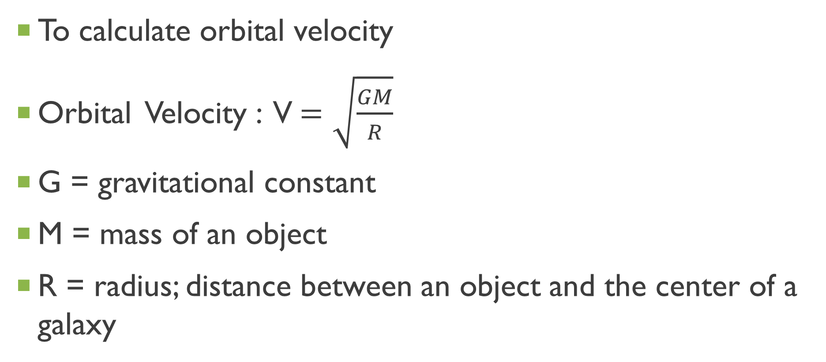
How?
To calculate orbital velocity
Orbital Velocity : V$=\sqrt{\frac{GM}{R}}$
G = gravitational constant
M = mass of an object
R = radius; distance between an object and the center of a galaxy

Slide 4
How?
3 Components
Bulge, Disk, & Halo

Slide 5
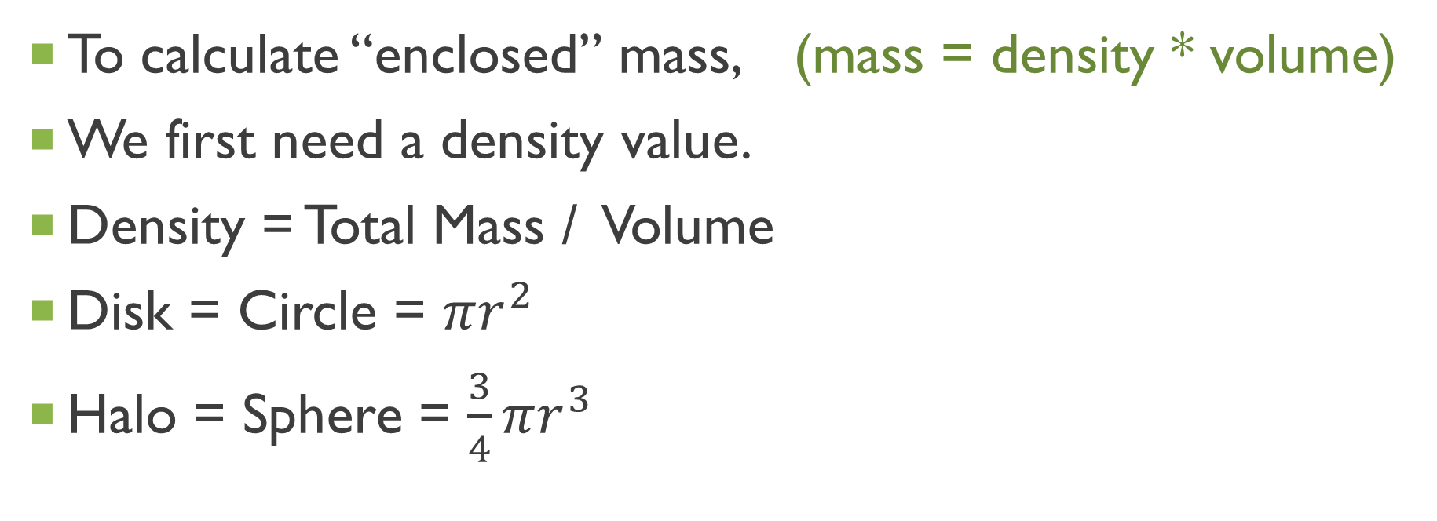
How?
To calculate “enclosed” mass, (mass = density * volume)
We first need a density value.
Density = Total Mass / Volume
Disk = Circle = $πr^{2}$
Halo = Sphere = $\frac{3}{4}πr^{3}$

Slide 6
step
1. Calculate density
2. Calculate enclosed mass of three components given radius
3. Calculate orbital velocity at each radius value
4. Make a plot to compare
5. Interpret variation of velocity as radius changes
Units: M = solar mass R = kpc V = km/s

Slide 7
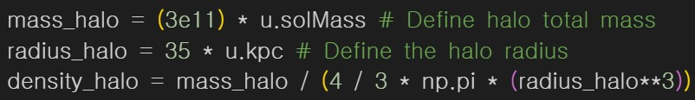
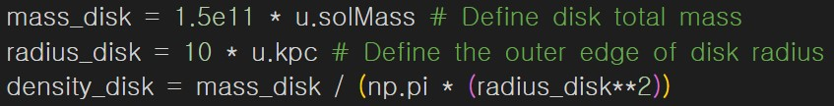
Step 1 DENSITY

Slide 8
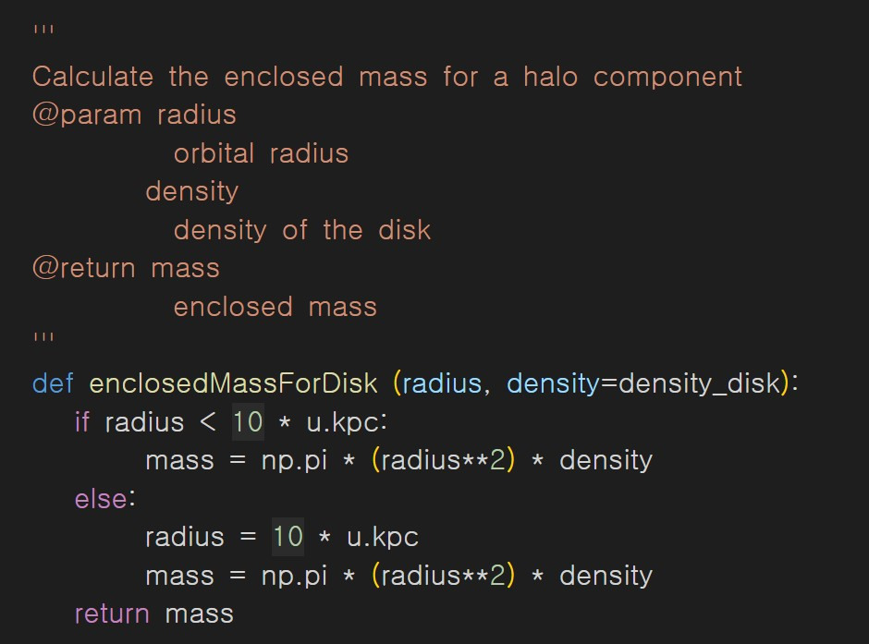
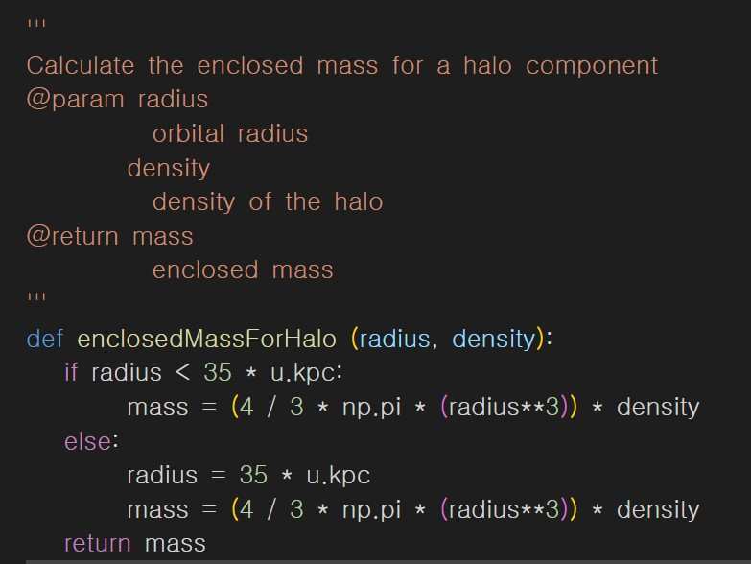
steP 2 ENCLOSED MASS

Slide 9
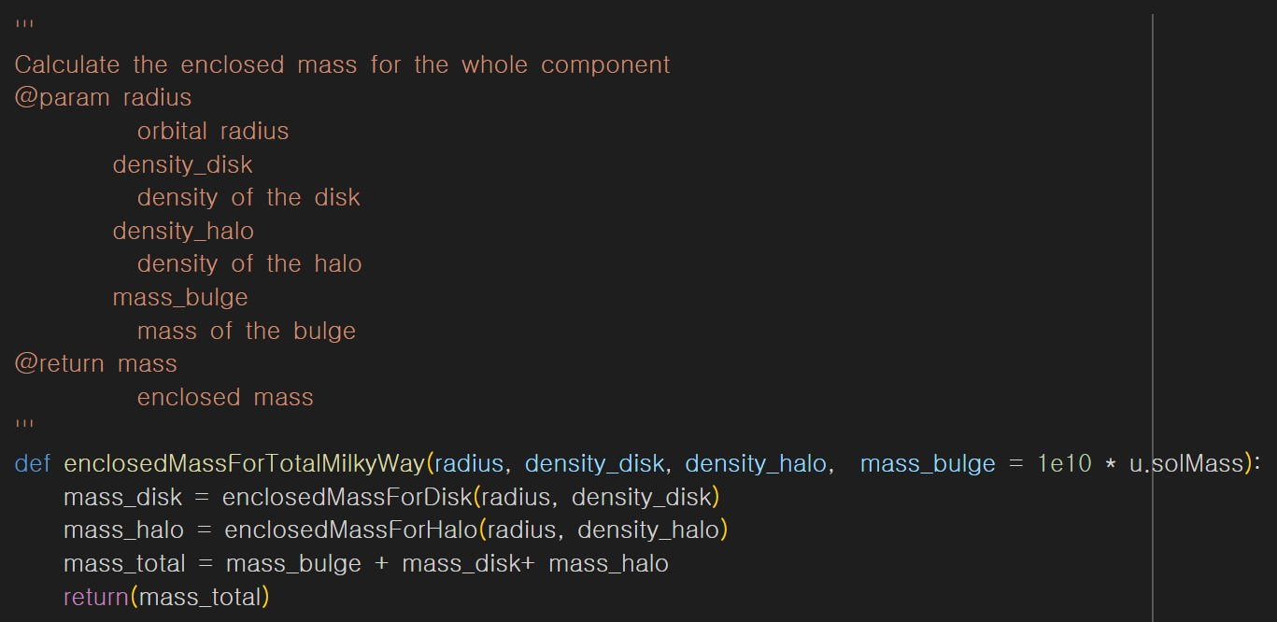
steP 2 ENCLOSED MASS

Slide 10
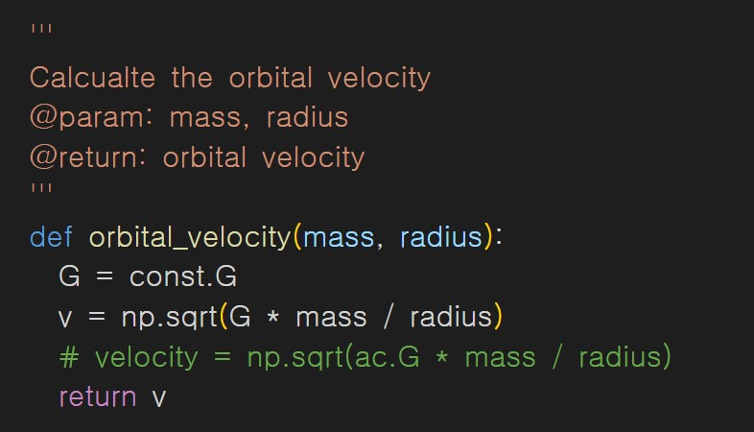
Step 3 orbital velocity

Slide 11
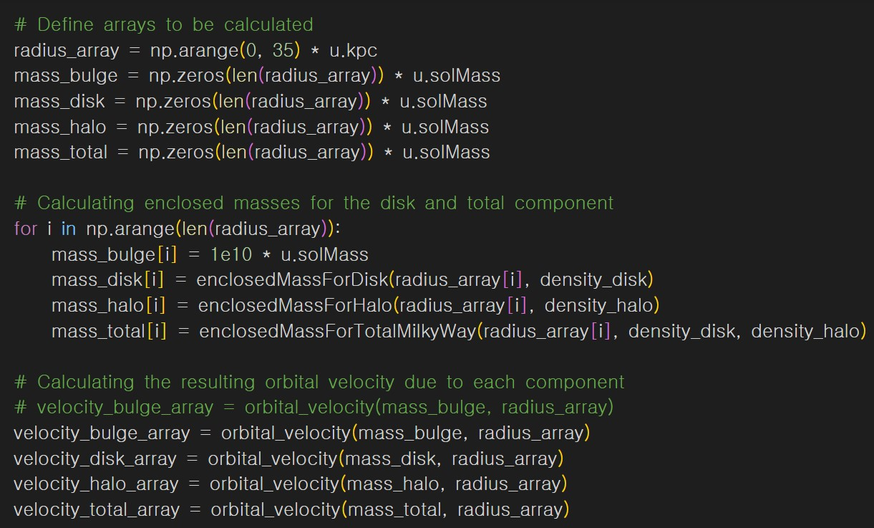
Step 3 orbital velocity

Slide 12
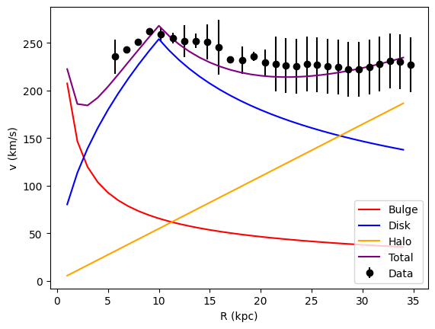
Step 4 plot = result
Range:
0 ~ 35 kpc
Unit:
Radius = kpc
Velocity = km/s

Slide 13
Conclusion
Rotation velocity is directly proportional to orbital distance up to 10 kpc.
Reason: rapid increase of disk mass(blue line) and relatively higher mass of bulge(red line)

Slide 14
Conclusion
After 10 kpc, rotation velocity decreases and slowly increases again
Reason: decrease of disk mass(blue line) and constant increase of halo mass(yellow line)

Slide 15
Conclusion
There’s gap between total and actual data.
We can assume the gap represents Dark Matter

